Slide 1


JABISU
VIRTUAL ASSISTANT
TEAM: CODE RIDERS
TEAM MEMBERS
MOHIT GOYAL
MAHIN RAZA
ASHUTOSH JHA
CHETAN SHARMA
MOHAMMAD UVAIZ
01

Slide 2

.
PROBLEM STATEMENT
We are all well aware about Cortana, Siri, Google Assistant and many other virtual assistants which are designed to aid the tasks of users in Windows, Android and iOS platforms.
In our modern world today, computers have become indispensible. People still find it difficult to manipulate computers properly and usually face problems even at a basic level, especially when they didn't receive any prior computer training.
SECUTRITY CONSERN OF PEOPLE WHO WILL WILL USE THERE VOICE AS THERE PASSWORD AND HOW TO MAKE THERE PAYMENT SECURE USING VOICE COMMAND.

Slide 3
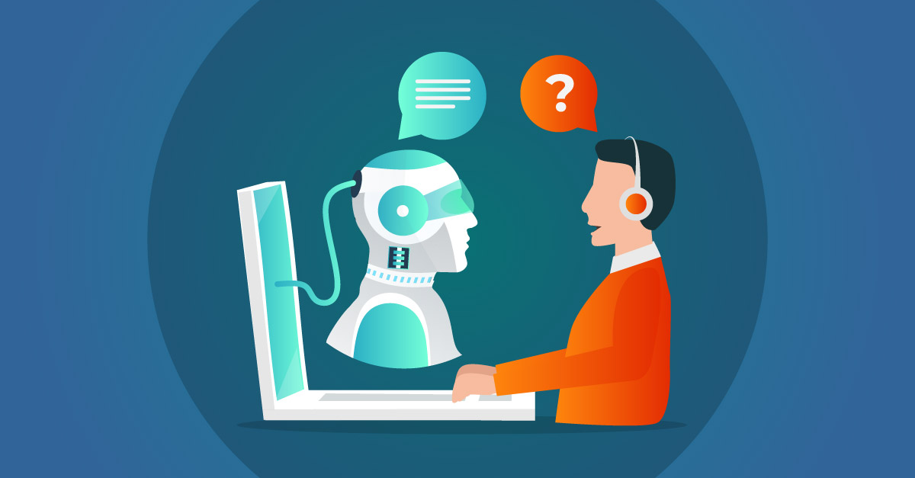
,
PROPOSED SOLUTION
JABISU CAN BE OPERATE IN DIFFERENT DEVICES IF YOU WANT TO USE IT IN LAPTOP OR ON YOUR SMART PHONES.YOU CAN SEND ,MULTIPLE MAILS AT SAME TIME WHICH EXISTING VIRTUAL ASSISTANT FAIL IN DOING SOO.
JABISU CAN BE HELPFUL FOR A NON TECH GUY THROUGH AN COMPREHENSIVE SET OF INSTRUCTION WHICH IS ACCISSIBLE TO EVERYONE.THROUGH IT SIMPLISITIC LOOK WE SEEK TO PROVIDE A PROFESSIONAL USERS AND RESPOND TO THEIR EVERY COMMAND IN A CONCISE AND TIMELY MANNER.
WITH VOICE BIOMETRICS TECHNOLOGY CONSUMERS VOICE CAN BE THERE NEXT PASSWORD IT IS ASSUMED THAT BY 2023 92.3% OF SMART PHONE USERS WILL USE VIRTUALL ASSISTANT FOR MOST OF THINGS.

Slide 4

WELL IT’S A GROING INDUSRTY AND ALREADY HAVING 5K TO 10K COMPRTITOR AND TO DEAL WITH THEM WE HAVE UNIQUE STRATEGIES WE KNOW THAT FIRSTILY WE HAVE TO TAGRET OUR INDIAN CUSTOMERS
3.
UNIQUE SELLING POINTS
TO MAKE ANY APPLICATION POPULAR THE BEST SITE IS REDDIT WERE ANY APPLICATION CAN BECOME POPULOR OVERNIGHT IT CAN BE A GAME CHANGER IF THEY FIND INTEREST IN OUR VIRTUALL ASSISTANT.
1.
IT IS PREDICTED THAT BY 2023 92.3% SMARTPHONE USERS WILL USE VOICE ASSISTANTS .
IN 2019 THE VIRTUALL ASSISTANT MARKET SIZE WAS VALUED AT 3 USD BILLION
AND IS PREDICTED TO REACH 44 USD BILLION BY 2027
GROWING AT A CAGR OF 37.7%FROM 2020 TO 2027.
4.
TO MAKE JABISU POPULAR AMOUNG YOUTH WE HAVE TO TAKE HELP OF INFLIENCERS LIKE ACTORS ,SPORTS PLAYER AND YOUTUBERS
AND TO MAKE IT POPULAR AMOUNG OLD PEOPLES WE WILL TAKE HEL[P OF OUR GOVERNMENT AND THROUGH THEM WE CAN INTERACT WITH PEOPLE AND TELL THEM HOW WE ARE DIFFERENT FROM OTHERS VIRTUALL ASSISTANT AND HOW THERE PRIVACY WILL BE SECURE HERE .
2.
5.
WE WILL PROVIDE OUR PRODUCT AT QUITE LESS AMOUNT TO OUR COUNTRY PEOPLE

Slide 5

WE HAVE USED PYTHON ,PHP, AND OBJECTIVE C
YOUR TECH STACK
1.
2.
WE HAVE USED SEVERAL ARTIFFICIAL INTELLIGENCE TECHNIQES,INCLUDING NATUARAL LANGUAGE PROCESSING,SPEECH RECOGNISATION,FACE RECOGNISATION,FOR DEVELOPING OUR JABISU.

Slide 6
THANK YOU
TEAM CODE RIDERS

